Slide 1
Customer Profiling for Loan Applications
By – Digant Vaibhav Gupta
9745032462

Slide 2
Introduction
A bank wants to create a profiling of customers to identify the segments of customers who more profitable and are less likely to default on the loans.
The data is available for 1,50,000 customers across 40 variables.
The company has data on customers involving the details about the demographic and credit bureau variables.

Slide 3
Solution Design Clustering
Solution Design is as follows:
Data Cleaning and Preparation
Scaling
Weighting : - Giving a weight of 3 to NPA_status and a weight of 2 to age, income, debtRatio and cl_util
As we have a large number of records we will look for number of clusters in the range of 7-10. It will ensure easy interpretability and accuracy.
The value of k which will give maximum CCC will be selected.
Cluster strength analysis
Cluster Profiling

Slide 4
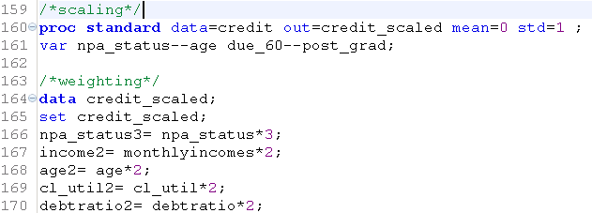
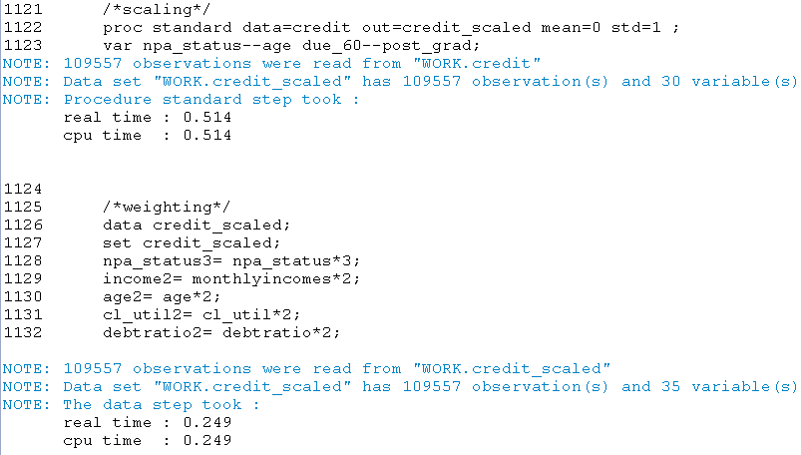
Scaling and Weighting

Slide 5
Run Proc fastclus for 7-10 Clearly k should be taken as 8

Slide 6
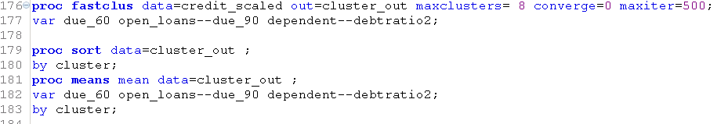
Running proc fastclus with k=8

Slide 7
Cluster Summary
Average ratio is 4.05 and maximum size of a cluster is 23% of the total population

Slide 8
Cluster 1-Major defaulters
This cluster has 808 people having the following characteristics. (0.73 % of population)
They have highest no of past defaults.
A person on an average paid dues later than 90 days 3 times as compared to 0.078 per person in population.
A person on an average paid dues 60-9 days late 1.3 times as compared to 0.058 per person in population.
A person on an average paid dues 30-60 days late 1.56 times as compared to 0.239 per person in population.
97 % people in this cluster are defaulters as compared to 6% in overall population.
They have utilized on an average 80% of their credit limit as compared to 30% utilization in overall population.
50% of the people in this cluster are from west as compared to 18% in overall population.

Slide 9
Cluster 2 Non-Defaulters High credit lesser open loans
This cluster consist of 17095 people(15.6%)
They have utilized 84% of their credit limit as compared to 31% utilization in population.
They have lesser open credit lines as compared to population.
They have on an average 6 open credit lines as compared to an average 9 in the population.
They have on an average 0.55 open real estate credit line as compared to an average 1.025 in the population.
Average age is 43 as compared to 51 of population.
They have very low default rate of nearly 0% as compared to 6% in population.
Income is fairly less as compared to population.

Slide 10
Cluster 3 Non Defaulters Senior people having more income and dependents
This cluster consist of 12659 people (11.5%)
They have high monthly income i.e average of 15,430 as compared to 6679 of population.
High number of open credit lines i.e average of 2 real estate credit lines as compared to 1 in population and average of 11.62 open credit lines as compared to 8.7 in the population.
Number of dependents are high i.e. 1.3 on an average as compared to 0.85 of population.
Low credit limit utilization i.e. 0.22 as compared to 0.31 of the population.
Non defaulters and average age of 54.

Slide 11
Cluster 4 Non defaulters Low income low credit
This cluster has 26108 people(23.83%)
Average age is 40 years which is much less than average age of population i.e. 51 years.
They have lower than average credit limit utilization, debt ratio and open credit lines.
They are essentially non- defaulters
They have lower than average monthly income.
They also non defaulters essentially.
Their previous record of dues payment is also better than the population.

Slide 12
Cluster 5 Defaulters Low income high credit use
This cluster consist of 2589 people(2.36%)
Heavy defaulters
78% credit limit utilization as compared to 31% of population.
50% of them are from west as compared to 18% in the population.
Average age is 40 years.
They have less than average open credit lines
More than average times default in payments
Fairly lower income group.

Slide 13
Cluster 6 Defaulters High credit high income
This cluster has 3173 people (2.89%)
These people are defaulters.
High number of late payments due 30-60 days.
High debt ratio of 0.49 as compared to .3 of population.
46% of them are from west.
High number of open credit lines.
High Income group

Slide 14
Cluster 7 Non defaulters Old age people less credit
This cluster has 25087 people.(22.89%)
Average age of this cluster if 68 years.
Low debt ratio and less number of dependents.
Very less number of real estate open credit lines.
Non defaulters
Most of the payments have been done on time in the past as compared to the population.

Slide 15
Cluster 8 Non-defaulters Low income high credit use
This cluster has 22038 population.(20.11%)
They have very high debtratio of 0.6 as compared to .3 that of population
High number of open credit lines.
Lower than average income but still they are not at all defaulters.
Most of the past payments have been done on time as compared to the population.

Slide 16
Cluster | % Freq | Age | Income | Credit Usage | Open Loans | Defaulters | West
1 | 0.73% | 45 | 5,120 | High | Low | Yes | 50%
2 | 15.6% | 43 | 5,183 | High | Low | No | 16%
3 | 11.55% | 54 | 15,430 | Low | High | No | 16%
4 | 23.83% | 40 | 5,637 | Low | Low | No | 16%
5 | 23.36% | 40 | 4,362 | High | Low | Yes | 49%
6 | 2.9% | 51 | 7,184 | High | High | Yes | 46%
7 | 22.9% | 68 | 5,647 | Low | Low | No | 16%
8 | 20.11% | 52 | 5,476 | Average | High | No | 16%

Slide 17
Thanks a lot
Have a Nice Day!!

